Slide 1
Audio Source Separation with DNNs
CECS 551
Presented to:
Professor Wenlu Zhang Ph.D
Presented by:
Abbasali Gulabiwala
Nolan Lucket
Yash Shah

Slide 2
Overview
Objective
Data Source
Preprocessing
Convolutional Model
LSTM Model
Combined Model
Conclusion
Audio Database
STFT
Audio Separation Model
Inverse STFT
Isolated Audio

Slide 3
Objective
To extract a single instrument from a mixture of multiple instruments
In this presentation, a violin was extracted from a mixture of
Violin
Flute
Mandolin
Guitar
Bass

Slide 4
Data Source
Medley DB provides 122 mixtures along with isolated tracks that are annotated
A Python library is provided that allows for particular tracks to be loaded
The songs by the artist “Phoenix” (not the popular band) were used in this project
This artist was chosen because of the simple and homogenous nature of the music
The training set is about 17 minutes long
The test set is about 2 minutes long

Slide 5
Preprocessing
Raw data is stereo audio in the WAV format
Stereo channels are averaged together to create a mono track
STFT calculation creates a frequency domain representation of the data

Slide 6
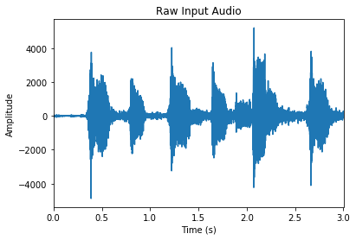
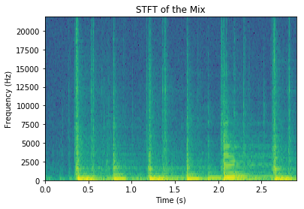
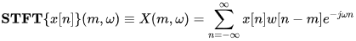
Short Time Fourier Transform
1
x: the signal to be transformed
w: a windowing function
m: the time step around which the DFT will be calculated
1) https://en.wikipedia.org/wiki/Short-time_Fourier_transform

Slide 7
CNN Model
Input 1
Conv1D
Permute1
Dense 1
Permute 2
Dense 2

Slide 8
Convolutional Model
Keras
Parameters
model_in = Input(shape=mix_train.shape[1:])
conv_1 = Conv1D(128, 32, …)(model_in)
transpose_1 = Permute((2,1))(conv_1)
fc_1 = Dense(128, …)(transpose_1)
transpose_2 = Permute((2,1))(fc_1)
model_out = Dense(2)(transpose_2)
model = Model(model_in, model_out)
input_1 (InputLayer) (None, 128, 2) 0
conv1d_1 (Conv1D) (None, 128, 128) 8320
permute_1 (Permute) (None, 128, 128) 0
dense_1 (Dense) (None, 128, 128) 16512
permute_2 (Permute) (None, 128, 128) 0
dense_2 (Dense) (None, 128, 2) 258
Total params: 25,090 Trainable params: 25,090 Non-trainable params: 0

Slide 9
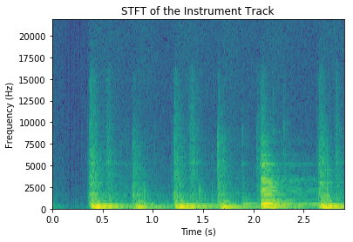
STFT
The Input Mixture
The Output Target

Slide 10
Convolutional Model
Keras
Parameters
model_in = Input(shape=mix_train.shape[1:])
conv_1 = Conv1D(128, 32, …)(model_in)
transpose_1 = Permute((2,1))(conv_1)
fc_1 = Dense(128, …)(transpose_1)
transpose_2 = Permute((2,1))(fc_1)
model_out = Dense(2)(transpose_2)
model = Model(model_in, model_out)
input_1 (InputLayer) (None, 128, 2) 0
conv1d_1 (Conv1D) (None, 128, 128) 8320
permute_1 (Permute) (None, 128, 128) 0
dense_1 (Dense) (None, 128, 128) 16512
permute_2 (Permute) (None, 128, 128) 0
dense_2 (Dense) (None, 128, 2) 258
Total params: 25,090 Trainable params: 25,090 Non-trainable params: 0

Slide 11
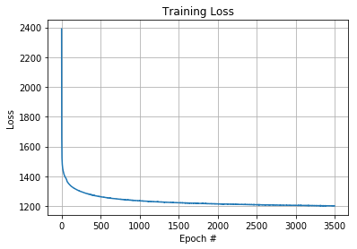
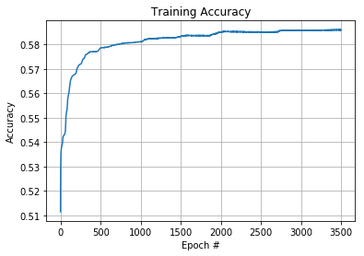
Training Results

Slide 12
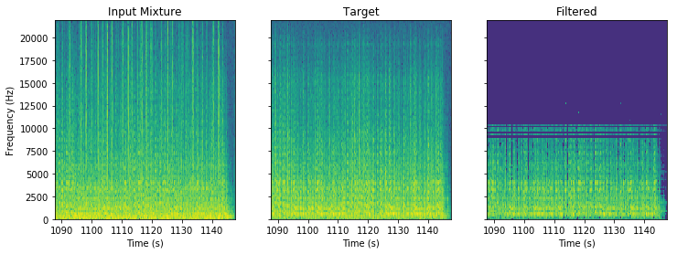

Result on Test Data (CNN)

Slide 13
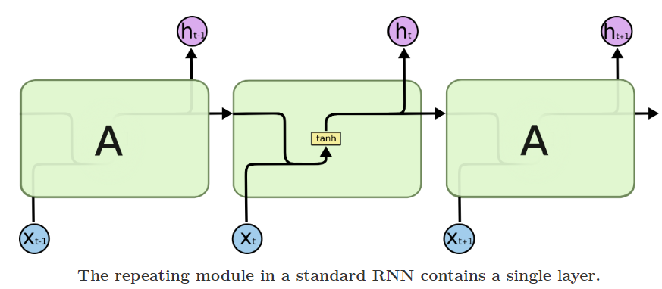
RNN ARCHITECTURE

Slide 14
WHAT IS LSTM?
Long Short Term Memory Networks (LSTM) are a type of RNN, which are capable of remembering information for longer periods of time.
Instead of having a single neural network layer, LSTM has four, interacting in a specific way.

Slide 15
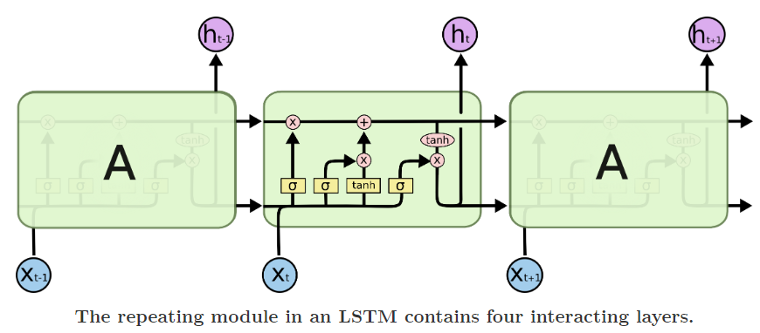
LSTM ARCHITECTURE

Slide 16
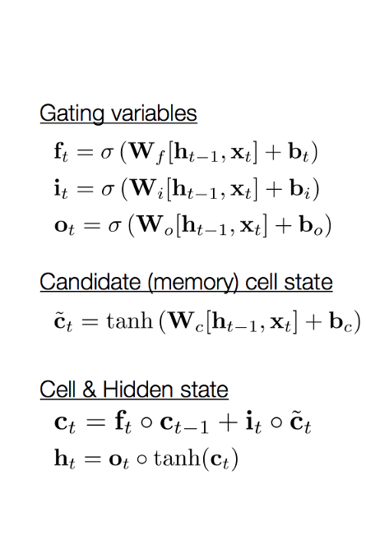
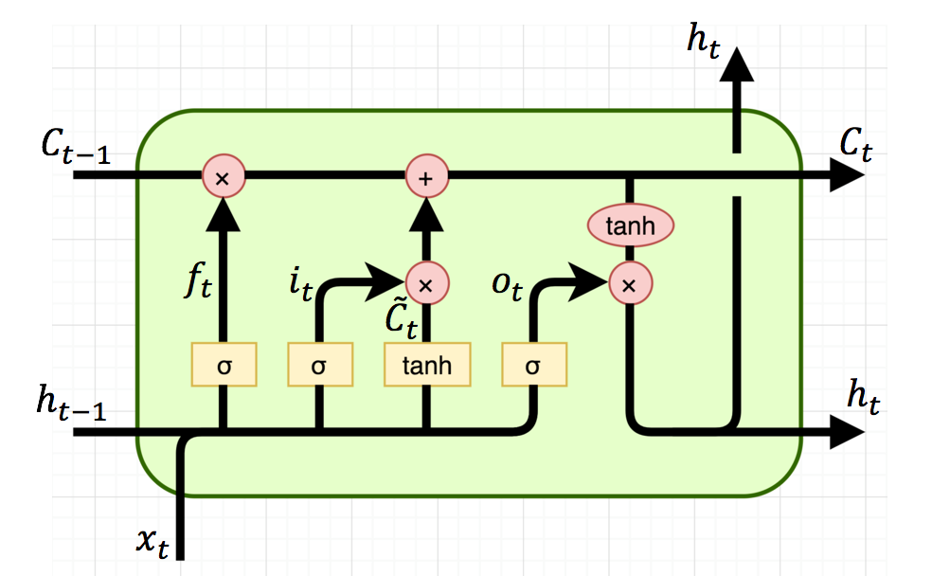
Understanding LSTM Network

Slide 17
LSTM Model
Input 1
LSTM
Permute1
Dense 1
Permute 2
Dense 2

Slide 18
LSTM Model
Keras
Parameters
model_in = Input(shape=mix_train.shape[1:])
lstm1 = LSTM(units=16, return_sequences = True)(model_in)
transpose_1 = Permute((2,1))(lstm1)
fc_1 = Dense(128, activation="relu")(transpose_1)
transpose_2 = Permute((2,1))(fc_1)
model_out = Dense(2)(transpose_2)
model = Model(model_in, model_out)
model.summary()
input_1 (InputLayer) (None, 128, 2) 0
Lstm_1 (LSTM) (None, 128, 16) 1216
permute_1 (Permute) (None, 16, 128) 0
dense_1 (Dense) (None, 16, 128) 16512
permute_2 (Permute) (None, 128, 16) 0
dense_2 (Dense) (None, 128, 2) 34
Total params: 17,762 Trainable params: 17,762 Non-trainable params: 0

Slide 19
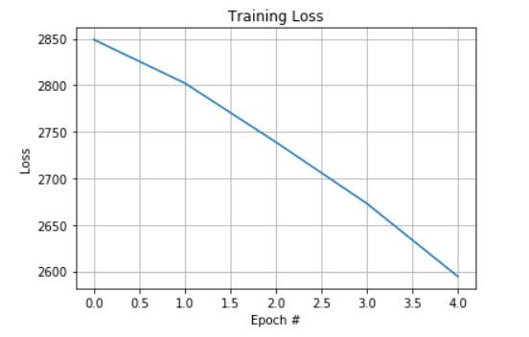
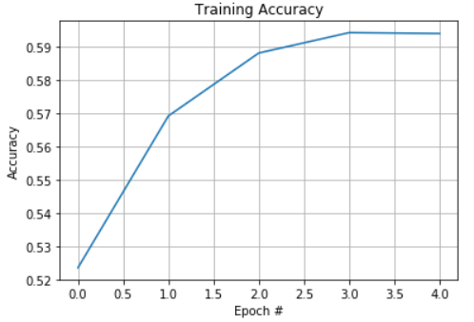
Training Results

Slide 20
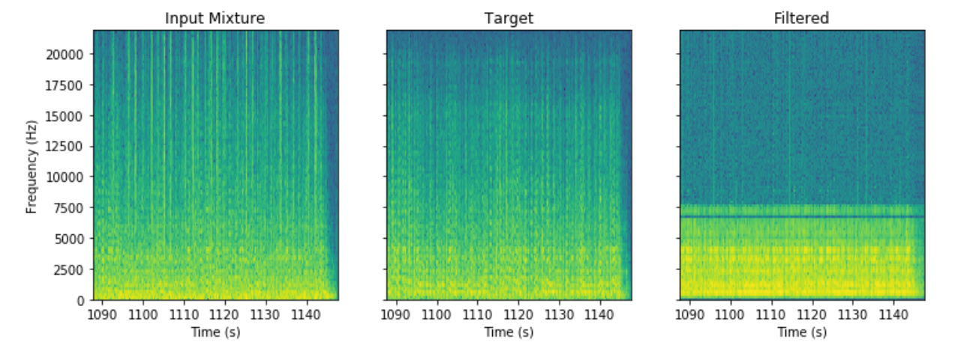
Result on Test Data (LSTM Network)

Slide 21
Combined Model
Input 1
Conv1D
Permute1
Dense 1
Permute 2
Dense 2
LSTM
Permute3
Dense 3
Permute 4
Dense 4

Slide 22
Combined Model
Keras
Parameters
model_in = Input(shape=mix_train.shape[1:])
Conv = conv_model(model.in)
Lstm = lstm(conv)
model = Model(model_in, lstm)
model.summary()
input_1 (InputLayer) (None, 128, 2) 0
conv (model) (None, 128, 2) 84354
Lstm(model)(None,128,2) 4546
Total params: 88900 Trainable params: 4546 Non-trainable params: 84,354

Slide 23
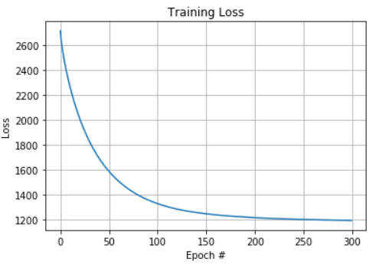
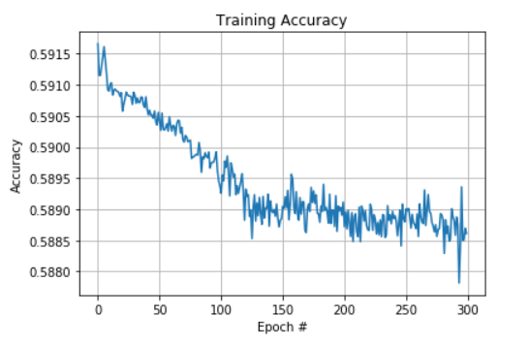
Training Results

Slide 24
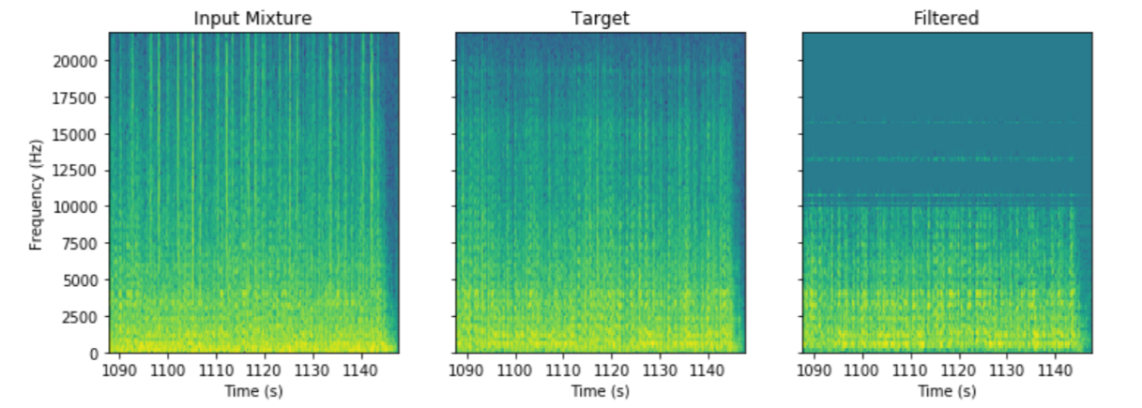
Result on Test Data (Combined Model)

Slide 25
Comparing all..
Model | Training Loss | Training Accuracy | Test Loss | Test Accuracy
CNN | 3505.766 | 58% | 1359.457 | 55%
LSTM | 2560.799 | 58% | 1597.695 | 56%
Combine | 1267.075 | 58% | 1459.799 | 59%

Slide 26
Conclusion
Training accuracy for all the models are almost same so, to make our model better we need to preprocess our dataset in a different way.
Combined model generates the output file on a better pitch then the CNN and LSTM models.
The train accuracy for the combined model was better just after 300 epochs where the CNN model takes more than 3000 epochs

Slide 27
Reference
[1] Takahashi, Naoya, Nabarun Goswami, and Yuki Mitsufuji. "MMDenseLSTM: An efficient combination of convolutional and recurrent neural networks for audio source separation." 2018 16th International Workshop on Acoustic Signal Enhancement (IWAENC). IEEE, 2018.
[2] Grais, Emad M., Dominic Ward, and Mark D. Plumbley. "Raw Multi-Channel Audio Source Separation using Multi-Resolution Convolutional Auto-Encoders." 2018 26th European Signal Processing Conference (EUSIPCO). IEEE, 2018.
[3] R. Bittner, J. Salamon, M. Tierney, M. Mauch, C. Cannam and J. P. Bello, "MedleyDB: A Multitrack Dataset for Annotation-Intensive MIR Research", in 15th International Society for Music Information Retrieval Conference, Taipei, Taiwan, Oct. 2014.

